Slide 1
Rock Paper Scissors Game using Socket Programming
By Group-18A
Group Members :
Abhinandhu A -AM.EN.U4AIE20002
Maddala H S M Krishna Karthik -AM.EN.U4AIE20046

Slide 2
Outline
SL No. | Topics | Slide No.
1 | Introduction | 3
2 | Types of Socket Programming | 4
3 | Rock Paper Scissors | 5
4 | Game Rules | 6
5 | Methodology | 7-8
6 | Results | 9-12
7 | Conclusion & Future scope | 13
8 | References | 14

Slide 3

Introduction
Socket programming is a way of connecting two nodes on a network to communicate with each other. The server forms the listener socket while the client reaches out to the server.
Most of the application-level protocols like FTP, SMTP, and POP3 make use of sockets to establish connection between client and server and then for exchanging data.
Sockets allow communication between two different processes on the same or different machines.

Slide 4
Types of Socket Programming
Stream Sockets : Delivery in a networked environment is guaranteed. These sockets use TCP for data transmission. If delivery is impossible, the sender receives an error indicator.
Datagram Sockets : Delivery in a networked environment is not guaranteed. They're connectionless because you don't need to have an open connection as in Stream Sockets. They use UDP.
Raw Sockets : These provide users access to the underlying communication protocols, which support socket abstractions. These sockets are normally datagram oriented.
Sequence Packed Sockets: They are similar to a stream socket, with the exception that record boundaries are preserved. This interface is provided only as a part of the Network Systems (NS) socket.

Slide 5
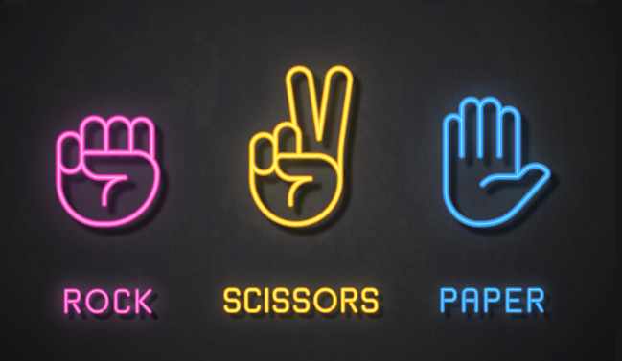
ROCK PAPER SCISSORS
Rock Paper Scissors is a hand game originated from China, usually played between two people, in which each player simultaneously forms one of three shapes with an outstretched hand. These shapes are "rock", "paper", and "scissors".

Slide 6
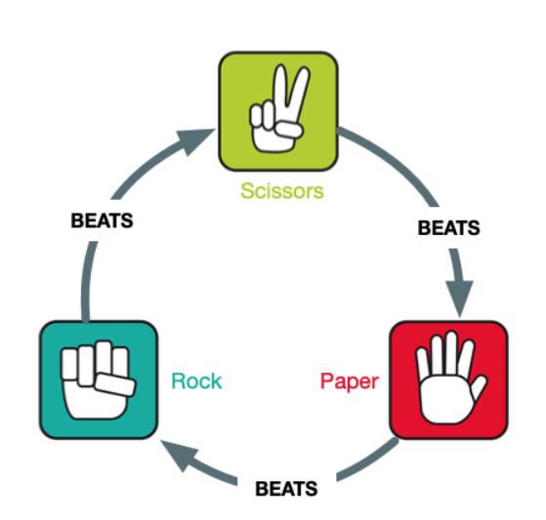
GAME RULES
Game rules are simple which are as follows:
Rock wins against scissors.
Scissors win against the paper.
Paper wins against the rock.

Slide 7
Methodology
Game client application
Game client application allows a player to connect to the game server and play against another connected player. (Game client windows)
Game logic/rule is implemented and handled in client side in order to reduce network communications to improve the game speed and efficiency.
Count-down timer and enabling/disabling of the choice buttons is created. (rock paper scissors buttons at the bottom of the client window)
Client-Server connection is implemented (Connect button) by creating a client socket object that connects to server.
Create a function that receives and decodes or interprets messages from the game server and updates the game client UI accordingly.
Handle the sending players choice to the server.

Slide 8
Contd..
Game server application
Game server application is responsible for handling game client’s connections and forwarding messages to the clients. (Game server window)
Start the server using the "start" button, after which the clients (players) can connect and start playing.
Create a function that accepting game clients connection requests.
Create a function that is responsible for handling sending and receiving of client’s messages.
The server doesn’t handle about the game information such as round number, winner and final results. because those are handled at the client side for efficiency.

Slide 9
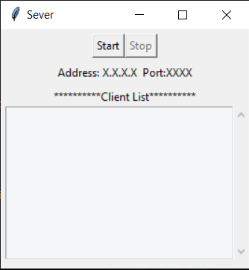
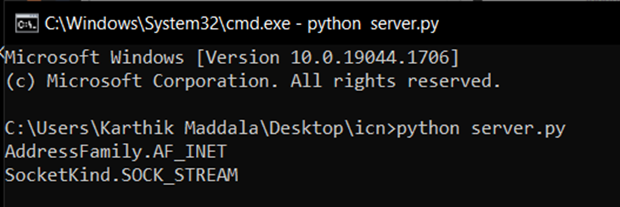
Results
Running server python file to initiate the game.

Slide 10
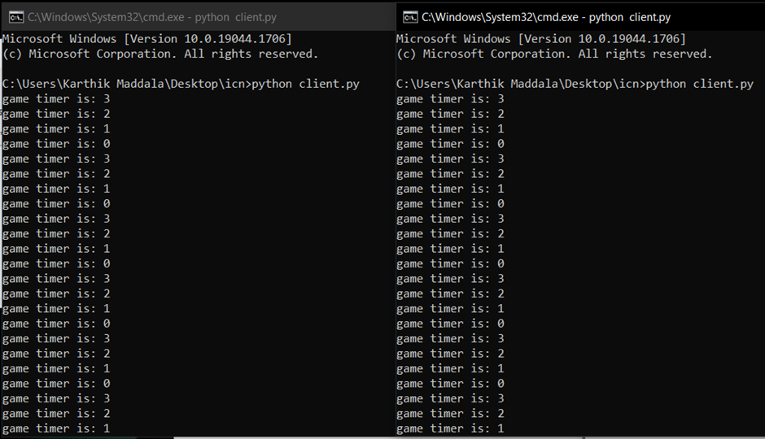
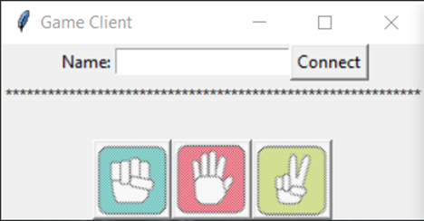
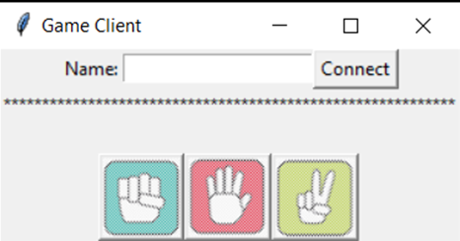
Contd..
Running two client python files to initiate two players.

Slide 11
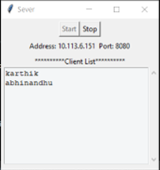
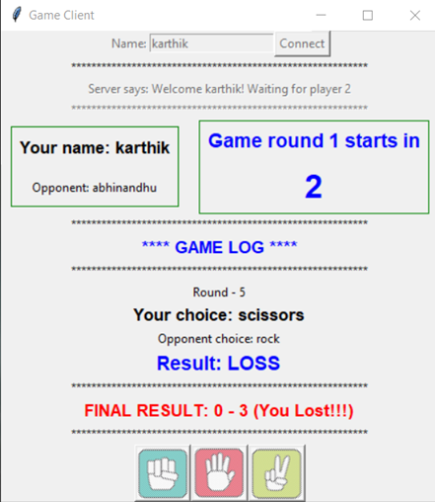
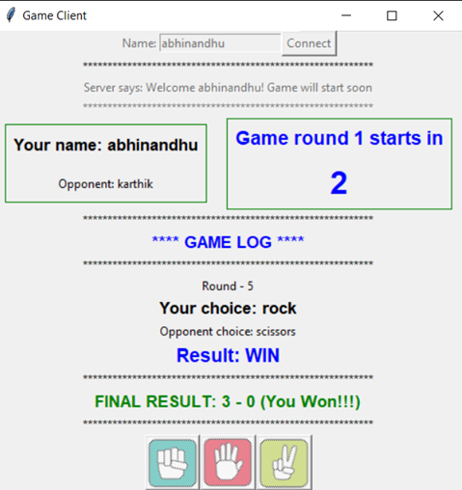
Contd..
Output after the game completed

Slide 12
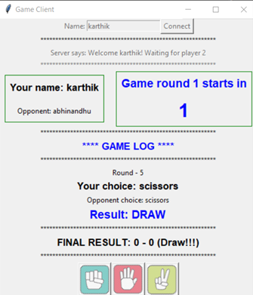
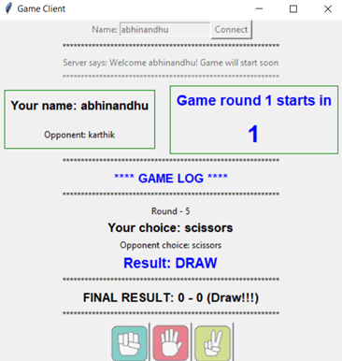
Contd..
Another output after the game completed.

Slide 13
Conclusion & Future scope
This project shows how to create a network game using python and socket programming by implementing the classic rock paper scissors game.
The principles used for creating the network game can be used to create other cool network apps and games.
In general, rock paper scissors game can be played by more than two players.
The present game is limited to number of players of two but it can be extended by adding feature support for more than two players.

Slide 14
References
https://www.geeksforgeeks.org/socket-programming-python/
https://realpython.com/python-sockets/
https://www.tutorialspoint.com/python/python_networking.htm
https://levelup.gitconnected.com/program-your-first-multiple-user-network-game-in-python-9f4cc3650de2
https://www.techwithtim.net/tutorials/python-online-game-tutorial/client/

Slide 15
Thank You

